Slide 1






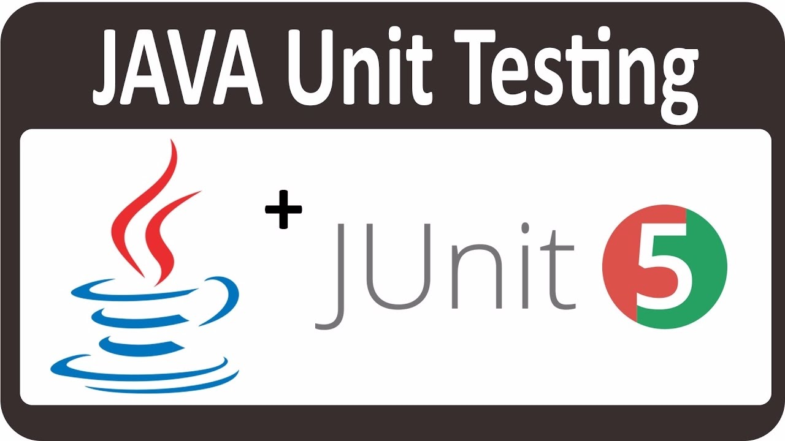

Architecture
Build tool
Automated built tool that connects CI tools.
Coordinator
Automated builds and tests with continuous deployment and continuous delivery.
Version control server
distributed version control and source code management (SCM) functionality
Version control client
Stores code
Changes in the repository is manipulated and managed
Code developer
Java, C/C++, JavaScript and PHP and installations of different plugins.
Test driver
tests can be run automatically and perform unit tests.

